Slide 1

Airbnb Guest Experience Advancement
Business Analytics Consulting Capstone Project: Final Project Presentation
Tourism Group Members:
• Jyotiraditya Singh
• Ashi Nishit Patel
• Akul Ahluwalia
• Sadman Rakin
• Deepanker Anand

Slide 2

Analysing Factors Influencing guest satisfaction
Streamline the booking process and host attraction.
Significance
Aims to contribute to
the platform's
credibility and long-term sustainability.
Methodology
Objectives
Analysing the Review data to see how it impacts the user experience
Introduction: Reshaping the Airbnb Guest experience
Strengthens Airbnb's
position in the
competitive market
Determining Key factors impacting guest satisfaction- Neighborhood, property
Using reviews to improve services
Analysing host behaviour and response rates

Slide 3




Geospatial and Neighbourhood Data
Property and Host Data
Booking Data
Review and Rating Data
Data and Methodology
Analyzing how property and host behavior impact the customers
Analyzing the reviews to determine how to improve satisfaction
Analyzing customer experience based on neighborhood
Analyzing booking and review frequency based on customer experience

Slide 4
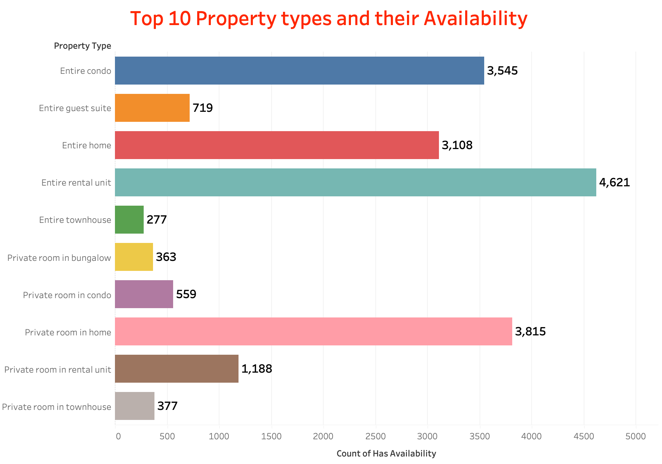
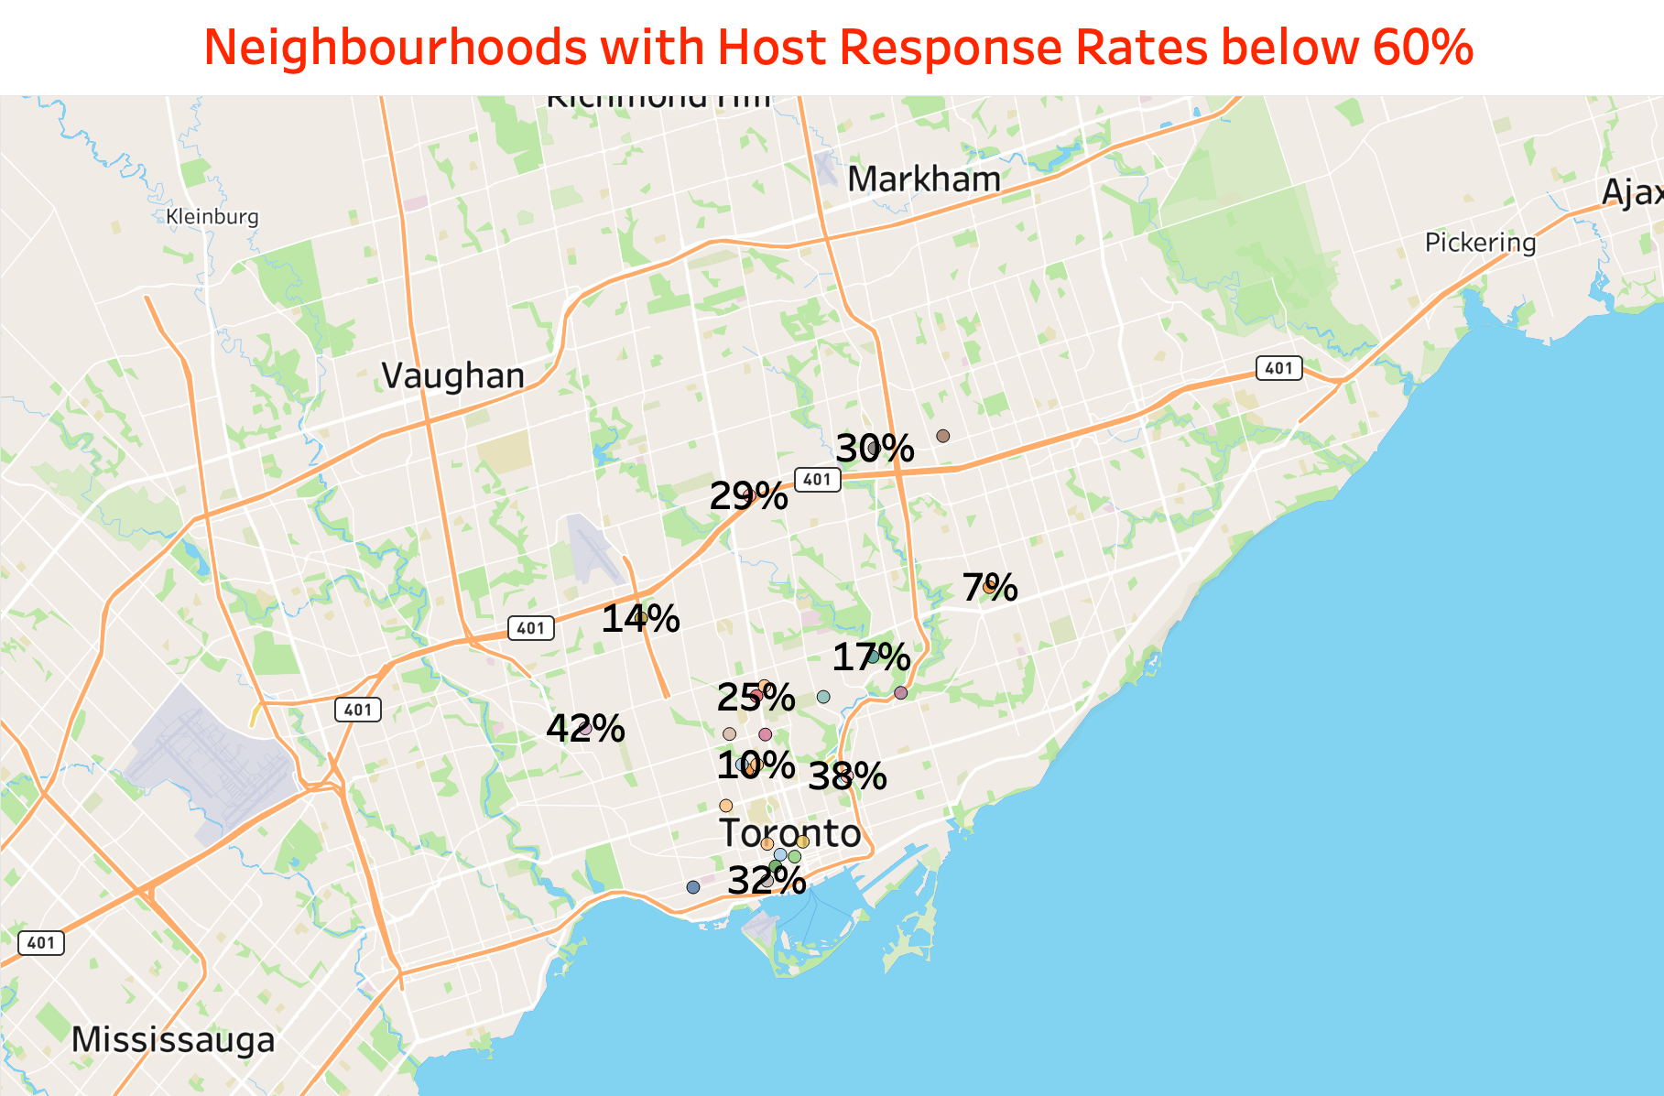
Objective: Determining Key factors impacting guest satisfaction – Neighbourhood, Property
Host response rates lower than 60% are indicative of subpar customer service, posing a potential risk of customer dissatisfaction over time

Slide 5
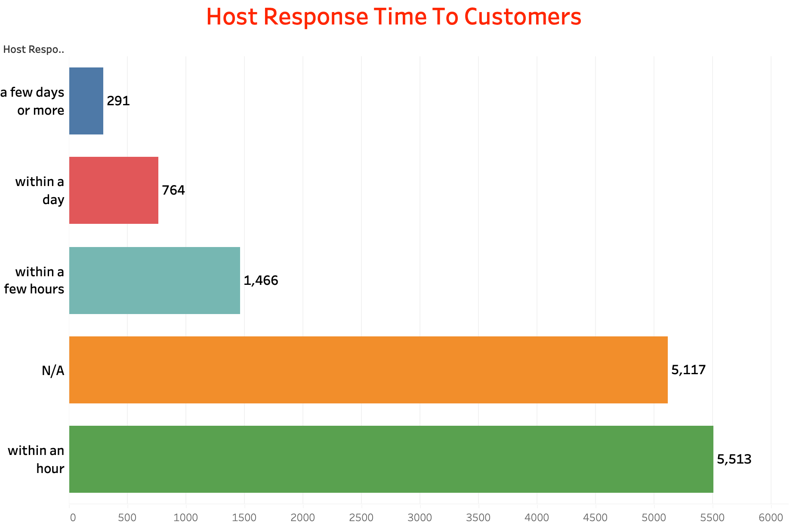
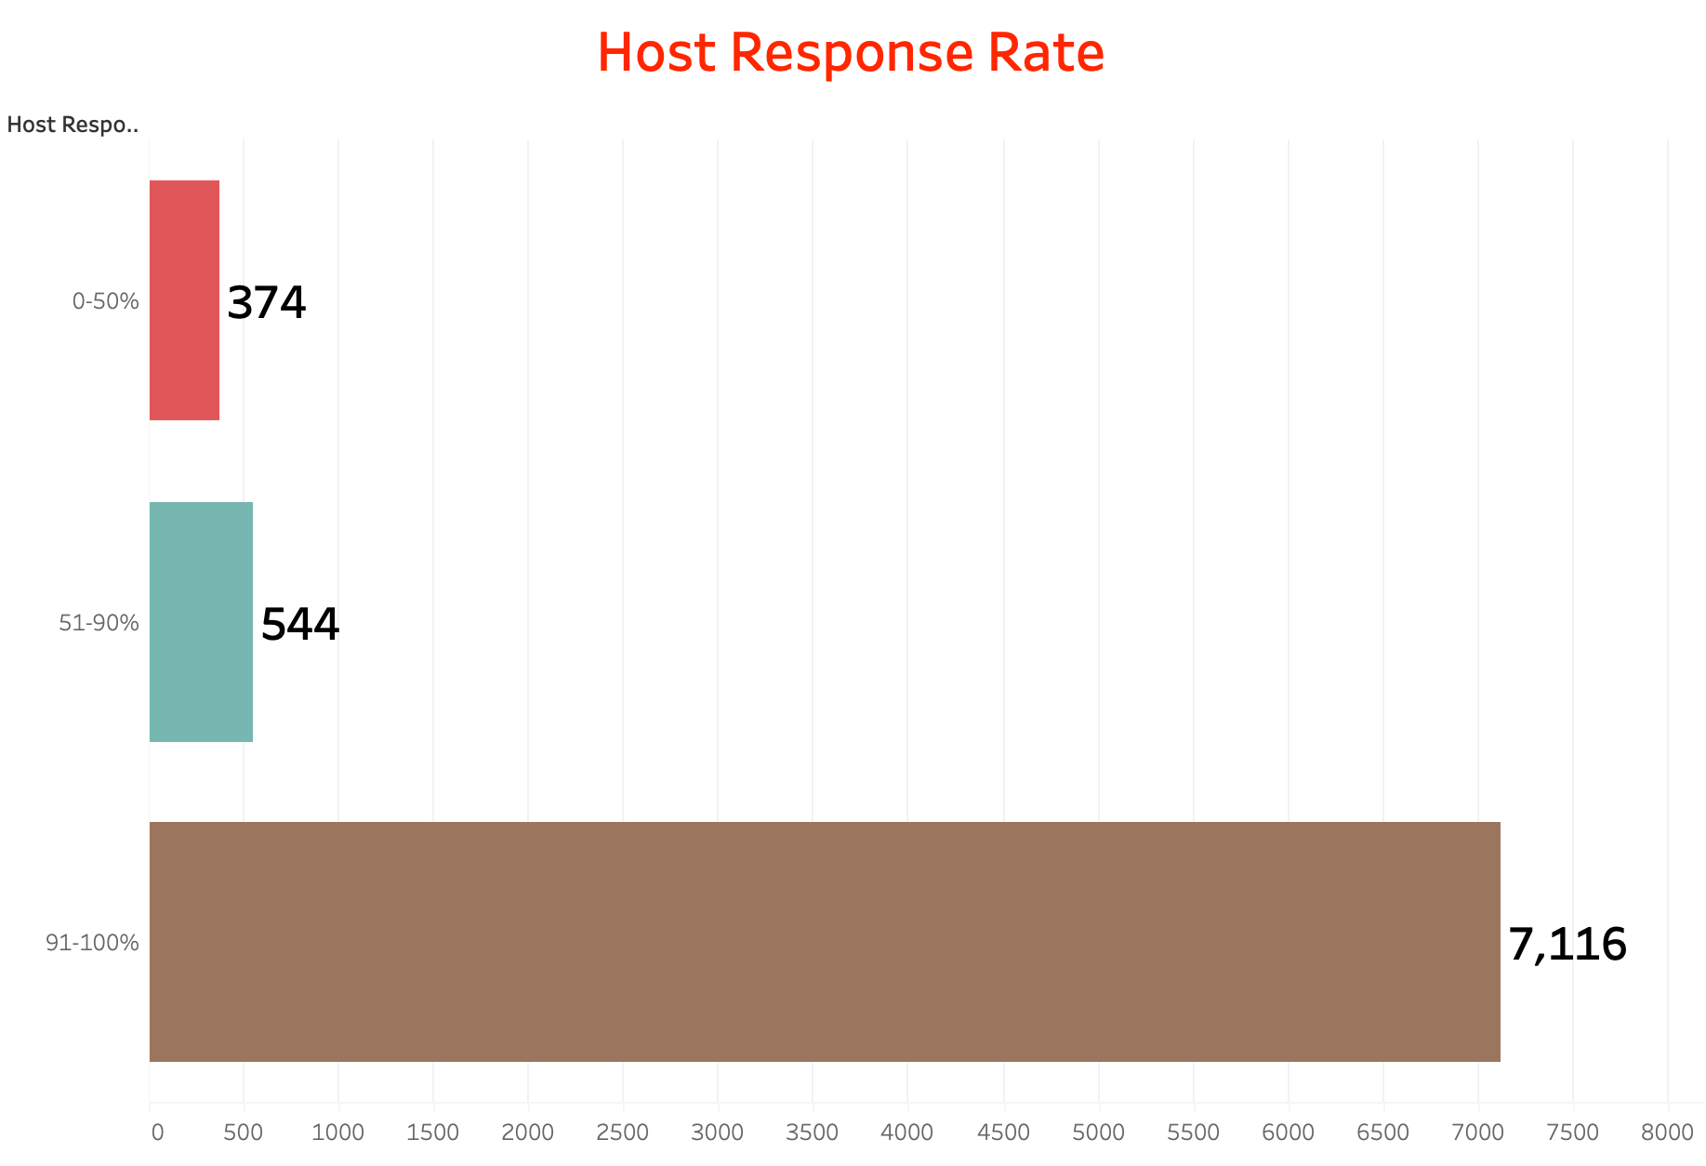
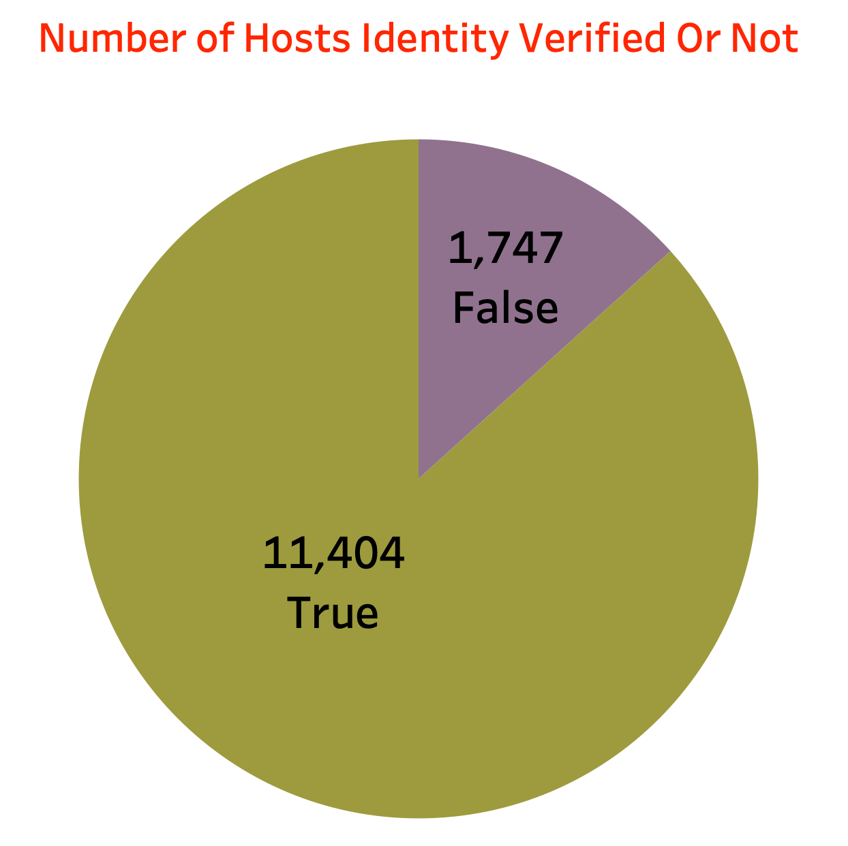
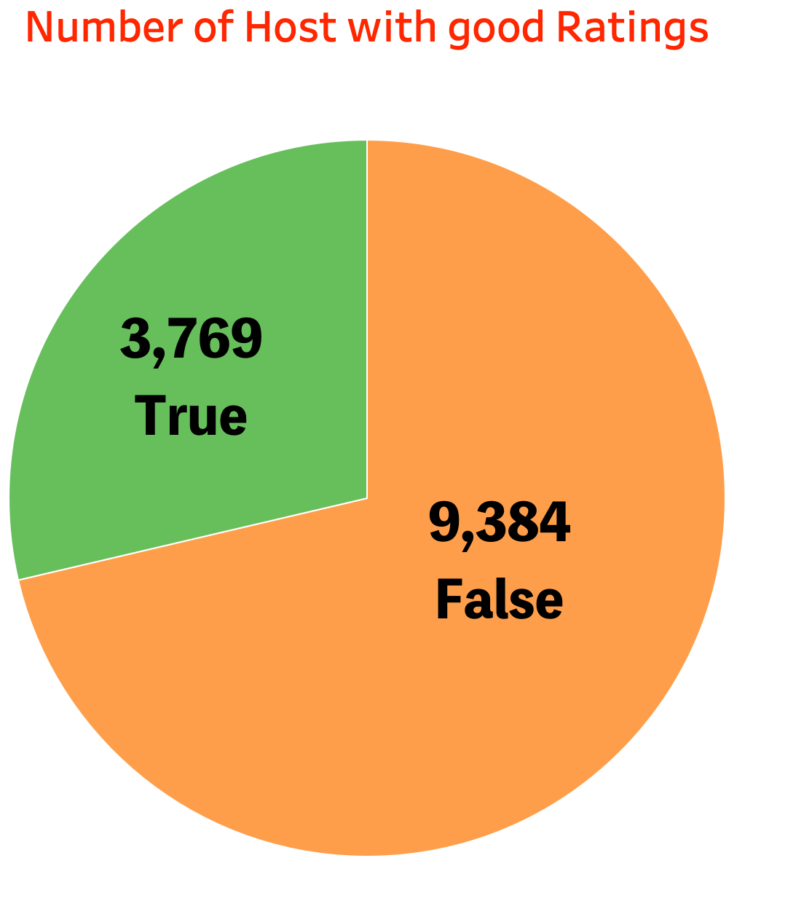
Objective: Streamline the booking process and host attraction.

Slide 6
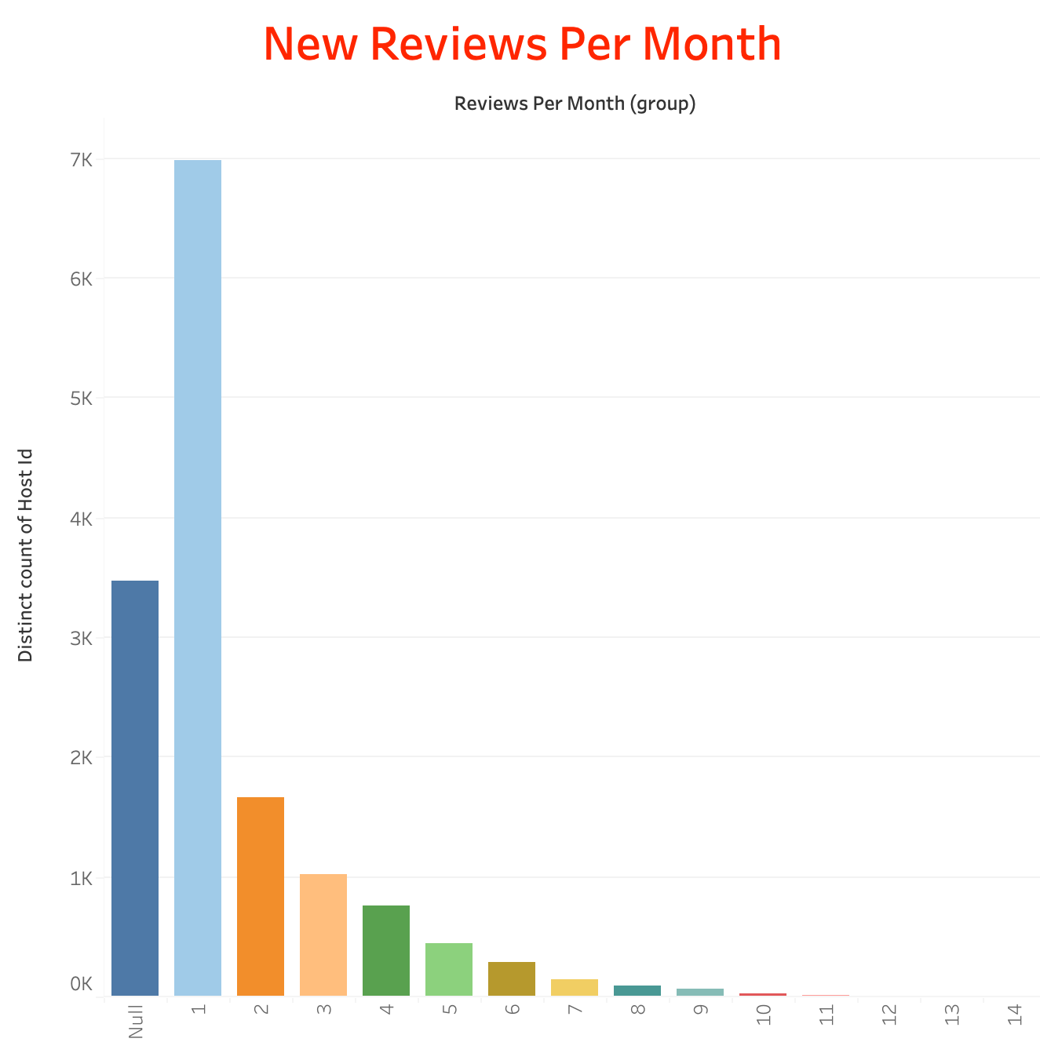
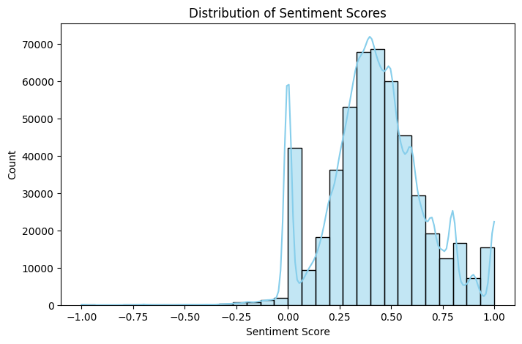
Objective: Analysing the Review data to see how it impacts the user experience
While the majority of reviews express positive sentiments, the negative ones serve as valuable insights for analyzing and enhancing the quality of our services.

Slide 7
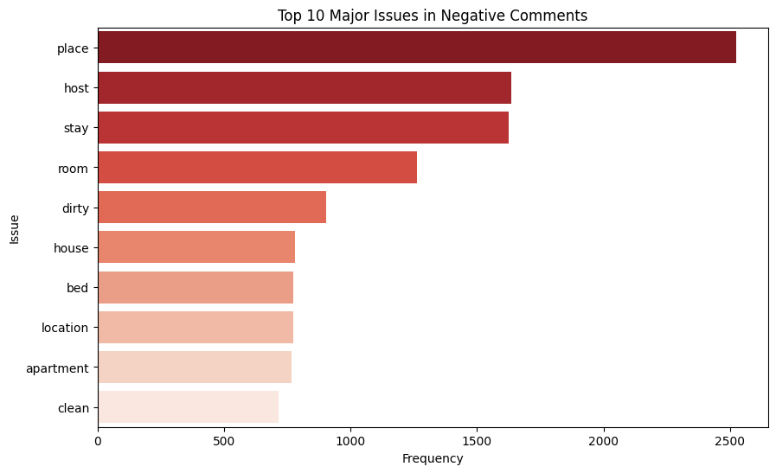
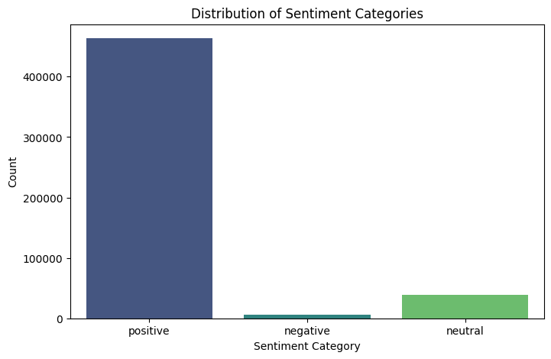
Objective: Analysing the Review data to see how it impacts the user experience
Frequency of the positive and negative Comments
Conducting sentiment analysis on user review comments reveals that the most common causes of customer dissatisfaction are related to the host, location, amenities, and tidiness, allowing for the identification of major issues.

Slide 8
Conclusion
Timely Response: 5513 hosts respond within an hour, emphasizing Airbnb's commitment to prompt communication.
Trust and Verification: 11404 verified hosts showcase dedication to safety; 1747 unverified hosts represent an opportunity for trust-building efforts.
Rating Boost: 3769 hosts with positive ratings, but 9384 hosts lack favorable ratings. Initiatives like workshops can enhance host ratings.
Proactive Support: Address concerns highlighted in sentiment analysis, focusing on location, host behavior, and cleanliness for improved guest satisfaction.
Positive Insights: Leverage insights from 400,000 positive comments to enhance the overall user experience.
Diverse Properties: Highlight diverse property types, including unique options, for a broader appeal and richer guest choices.
Strategic Growth: Addressing these points strategically ensures Airbnb's competitive edge and long-term success.

Slide 9
Recommendations
Enhance Host Verification
Improve Host Ratings
Address Common Guest Concerns
Encourage Timely Responses
Invest in Sentiment Analysis Tools
Diversify Property Types
Continuous Improvement

Slide 10
Implication for Business Managers:
Strategic Resource Allocation
Brand Perception Management
Data-Driven Business Intelligence
Continuous Monitoring Framework

Slide 11
Limitations of the Project:
Inherent Subjectivity
Temporal Context
Cultural Variances
Platform-Specific Dynamics
Lack of data

Slide 12


Thank You!

